Slide 1
CSE 335: Phase 3-Final
Jacob Peters

Slide 2
Project Idea
The idea for the project is based around a nutrition app called MyFitnessPal
The general purpose of the app is to track your daily food intake and try to keep your nutrition within certain boundaries
Key elements I implemented are:
The ability to create and save meals
To add those meals to your daily intake
To locate your nearest Whole Foods Grocery Store

Slide 3
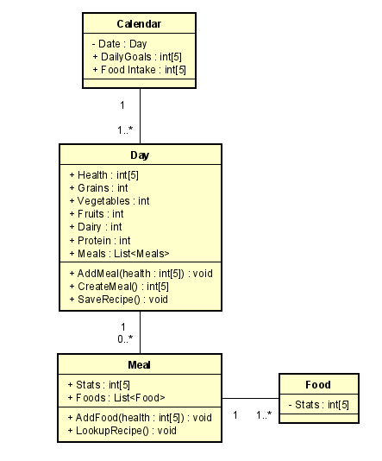
Class Diagram
Key Points: A Calendar day consists of the goals and the actual food intake.
Days consist of your list of meals and the number of each food group total that day
Meals are consisted of the different food items that you add for each meal you eat
And Food consists of the nutrition stats of the food that you want to add.

Slide 4
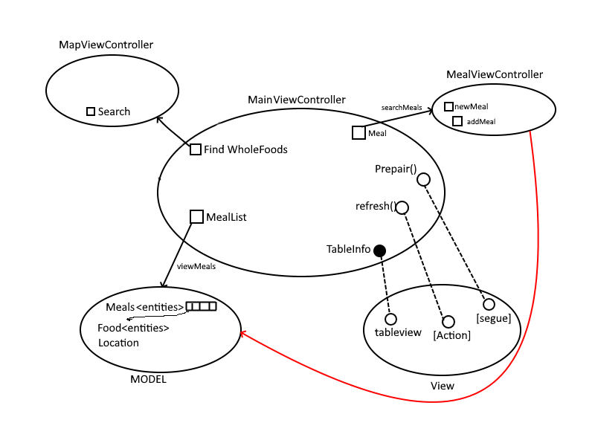
MVC

Slide 5
Project Limitations
Permissions issues with xcode: Location
Loading times between ViewControllers:
No access to Iphone → no access to camera/disabled camera
Elements shifting / Having to switch between table view controllers and view controllers with a table view element
No easily accessible/useable calendar API

Slide 6
Lessons Learned
Write smaller versions of code for each type of problem and implement them separately
Try to have actual access to a Mac at home instead of going in to the labs or renting one. One I could hopefully have admin privileges on…
That if you have enough issues and time to solve code you begrudgingly will eventually like a coding language.

Slide 7
Suggestions
Given how this semester has gone and I feel like i still learned a ton, there is not much I can say for the class.
I enjoyed it and learned a new skill-set that I could potentially use in the future.
Had the whole semester been in person and allowed for normal class schedules to continue, I am sure that everything would have been even better.

